Slide 1
Final Tik Quiz
CAPSTONE PROJECT
Presented By:-
Name- Amit Kumar Singh
College Name- Cimage College Patna
Department – BCA
AICTE Student ID: STU6879af92a1f421752805266

Slide 2
OUTLINE
Problem Statement
System Development Approach
Algorithm & Deployment (Step by Step Procedure)
Result
Conclusion
Future Scope(Optional)
References

Slide 3
Problem Statement
Students and educators lack a simple, engaging platform for practicing subject-based quizzes.
Existing tools are either too generic or lack customization by class, category, and difficulty.
There’s a need for a responsive, visually appealing quiz app that supports dynamic question loading and real-time feedback..

Slide 4
System Approach
Frontend Technologies-
HTML5: Structure and layout
CSS3: Styling, responsive design, hover effects
JavaScript: Dynamic logic, timer, navigation, score tracking
Bootstrap: Grid system and UI components
Design Philosophy-
Clean and vibrant UI
Mobile-first responsiveness
Accessible and intuitive navigation

Slide 5
Algorithm & Deployment
Quiz Flow:
Class/category/difficulty selection
API fetch for dynamic questions
Timer logic and navigation controls
Score calculation and display
Deployment:
Hosted on for fast, free access
Responsive across devices and browsers

Slide 6
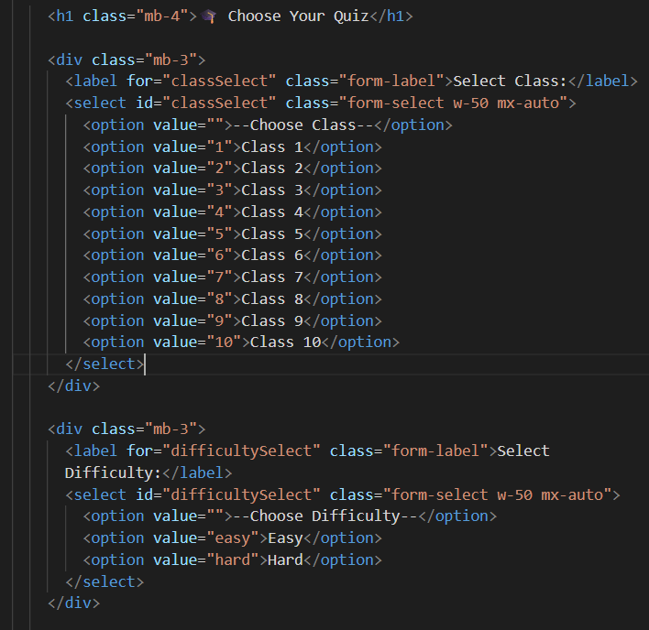
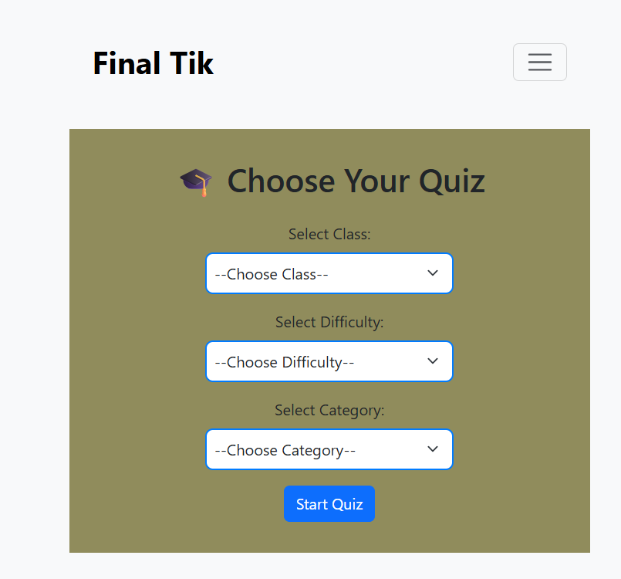
Result
Fully functional quiz app with dynamic question loading
Responsive UI with hover effects and color enhancements
Live demo: https://final-tik-quiz.netlify.app/
GitHub repo: https://github.com/Amit-coding-world/Final-Tik-Quiz.git

Slide 7
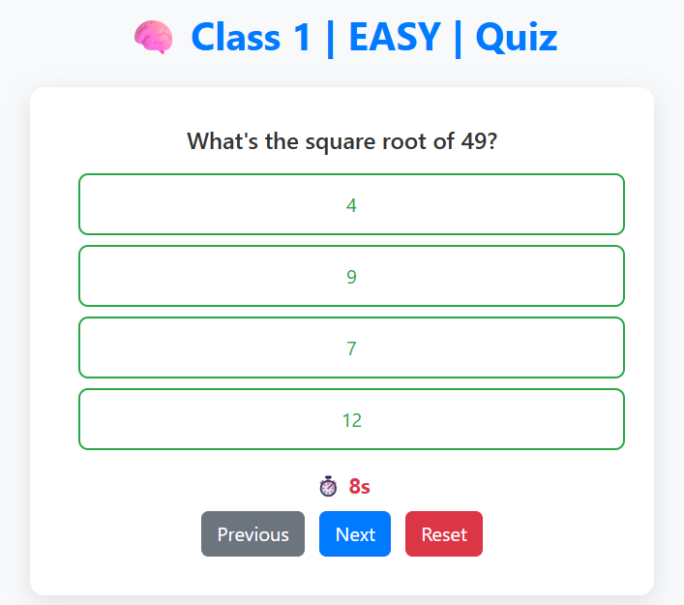
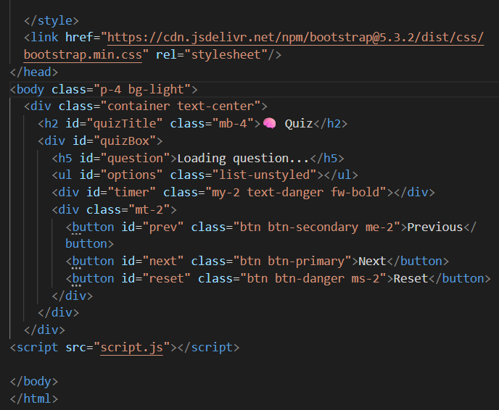

Slide 8
Conclusion
Final Tik Quiz offers a lightweight, customizable quiz experience for students.
It simplifies learning through interactive design and real-time feedback.
The platform is scalable and adaptable for various educational needs.

Slide 9

Future scope(Optional)
Add review mode for incorrect answers
Score persistence using local storage or backend.
Admin dashboard for quiz management
Gamification elements (badges, streaks)
AI-based question recommendations

Slide 10
References
Bootstrap v5.3 Documentation
Open Trivia API
›››Live demo: https://final-tik-quiz.netlify.app/
››› GitHub repo: https://github.com/Amit-coding-world/Final-Tik-Quiz.git

Slide 11
THANK YOU

